Slide 1
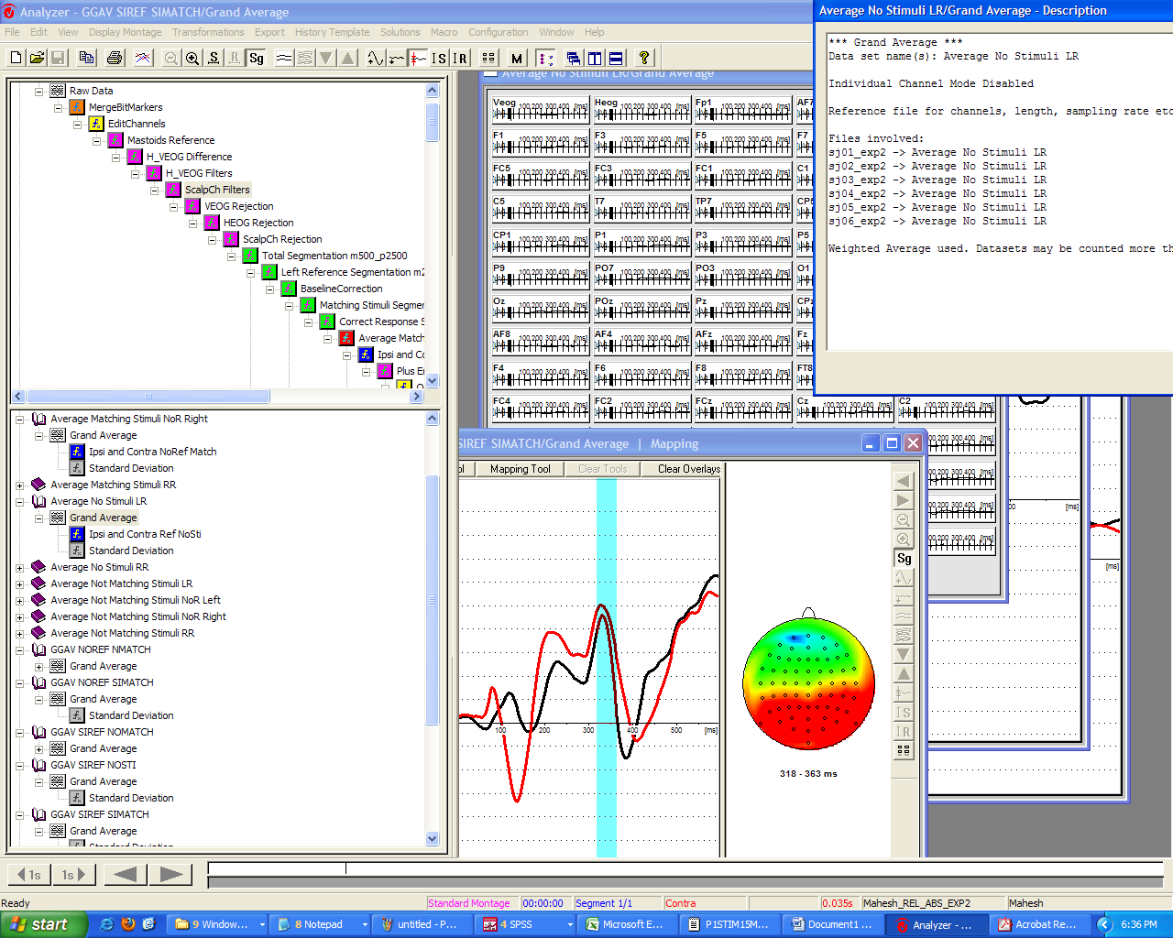


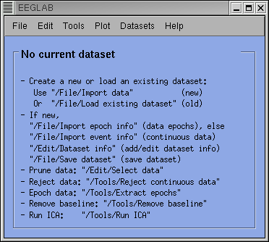


HOW TO PERFORM OUR EEG ANAYSES IN EEGLAB
A.K.A. …
…how to get involved with something:
Easier,
Faster,
Beautiful, and much, much more:
_Free
_Shareable
_Powerful
_Flexible & Compatible
_Continuously upgraded
_Useful to teach us Matlab
_Allowing for a cost-effective
tracking of our analyses
etc…etc…etc…

Slide 2
Stage 1 (from 0 to epoching): LET`s START
What you need:
_a release of MATLAB
(better if: _7.x or above
_64bits )
a)BASIC USAGE:
_a release of EEGLAB
(better if: _the last one )
_a release of ERPLAB
(Specific ERPs tool developed by Luck as a plugin of EEGLAB)
_a release of ADJUST (for thresholded ICA-AR)
_a release of D. GROPPE`s
b)IF YOU WANT TO GO WILD:
MASS UNIVARIATE ERP TOOLBOX (for complex stats on ERPs ), J.DIEN’s PCA TOOLBOX (mainly for blind source separation)..or whatever…
_a bunch of PERSONALIZED
FUNCTIONS to speed up the
basic steps (faster if: _you use the ones I already wrote)

Slide 3
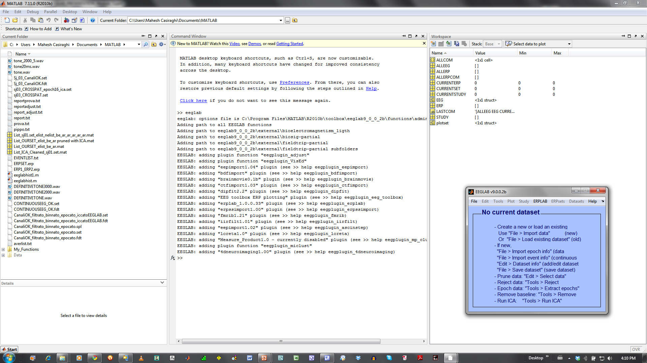
LET`s START
OK, I eventually installed Matlab, Eeglab, and Erplab. I have my .BDF here. Now?
STEP 1: Double click on MATLAB’s icon.
OK, a window opened, and it is full of unintelligible words and symbols. Now?
STEP 2: You should see this: >> symbol, followed by a blinking: |. Type: eeglab and press enter.
If everything is working, the above display should be prompted.

Slide 4
For the next few steps, you will need to use some M_() functions, in which I put together some code to simplify things.
OK, I want to read my .BDF. Show me how.
STEP 3: M01_BDF2SET()
Use: function [EEG] = M01_BDF2SET(filename, filepath, newfilename, newfilepath, referencechannels)
Example: [EEG] = M01_BDF2SET('sj01.bdf','C:\\BDFs\\','sj01.set','C:\\SETs\\',[65,66])
Now you have a .set (EEGLAB standard file format) file saved where you specified: you won’t need the .BDF anymore.
Although there are several methods for importing .bdf files, after having tried them, the only one that seemed to work reliably to me was the pop_biosig function, which makes use of the BIOSIG toolbox by Alois Schlögl (should already be present in your eeglab installation, or you can download it in alternative from his page). For a list of all supported formats for conversions (r/w): http://pub.ist.ac.at/~schloegl/ .

Slide 5
I want to check if my markers are there or if your method miserably failed.
STEP 4: M05_INFOMARKERS()
Use: function [markmat] = M05_InfoMarkers(eeg structure)
Example: [markmat] = M05_InfoMarkers(EEG)
OK, I see something weird in my markers
The BIOSIG toolbox correctly imports signal and markers into EEGLAB, but for mysterious reasons (common problem highlighted online by several other researchers) it adds 65280 to each marker from our BIOSEMI system.
I told you that EEGLAB was bad: now what do I do to solve such a mess?
STEP 5: M011_ChangeNumberMarkers()
Use: function [EEG] = M011_ChangeNumberMarkers(filename, filepath, operation)
Example: [EEG] = M011_ChangeNumberMarkers ('sj01.set', 'C:\\SETs\\', '-65280')

Slide 6
If my PC crashes?
I want to save my dataset, now.
STEP 6: pop_saveset()
Use: function [EEG] = pop_saveset( EEG, 'filename', OUT_filename, 'filepath', OUT_directory);
Example: [EEG] = pop_saveset (EEG, 'filename', 'sj01.set','filepath', 'C:\\SETs\\');
Why do I save if I don’t know how to load?
STEP 7: pop_loadset()
Use: function [EEG] = pop_loadset(filename,filepath)
Example: [EEG] = pop_loadset('sj01.set','C:\\SETs\\')
Waves, waves, I want to see waves, where are the waves?
Awful
STEP 8: eegplot()
2 ways:
Use: eegplot(EEG.data) [depressing output: useful for fast monitoring]
STEP 9: M02_waveforms()
Awesome
Use: M02_waveforms(EEG) [colourful output: useful for in-depth analysis]

